Slide 1
Module 4: The vacillating Giant
Talk | Title | Time Period | Date of Talk
23 | USA and the 20th Century | 1898-1900 | September 2nd
24 | The Progressive era | 1900-1916 | September 16th
25 | USA and world War One | 1914-1918 | October 21st
26 | The retreat to “normalcy’ | 1918-1920 | November 4th
27 | The Roaring Twenties | 1921-1929 | November 18th
28 | Great Depression and New Deal | 1929-1938 | December 2nd
29 | USA and the 1930’s world | 1932-1939 | December 16th

Slide 2
American History
1
Talk 29: Great Depression and New Deal (1929-1938)

Slide 3
Great Depression & New Deal (1929-1939)
Market crash, Great Depression, and Dustbowl
The Republican response (1929-1932)
……………….Musical interlude………………………..
Franklin Delano Roosevelt and the New Deal (1932-1940)
Eleanor Roosevelt

Slide 4
Market Crash and Great Depression

Slide 5
Roaring Twenties 1921-1929
The 1920’s USA a booming economy
Rising standard of living wages rise 40% , prices 10%
Rising international trade…modest US tariffs, US loans fund German reparations and economy
Unprecedented rise of consumer lending (from 3% to 7% of GDP) by ‘new’ middle class
75% durable goods bought on credit
15% US public investing in stocks by 1929
“Anything goes” Financial System
Federal Reserve created 1912 but decentralised….decisions based on consensus…none
Margin stock buying (buy $100 stock, 10% down payment, 90% due in future)
Banks as speculators ..Commercial banks also active traders
Insider trading rampant
…..certainty of future price rises…this is the ”New Economy”

Slide 6
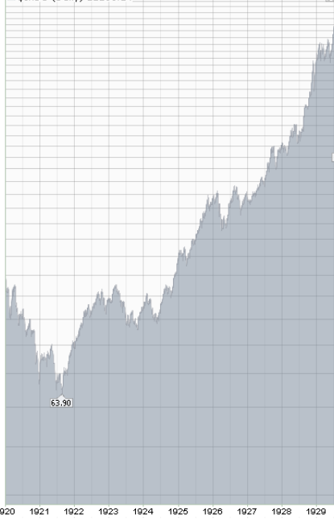
Booming Stock market
Dow Jones Index
1920-October 1929
Dow Jones index rose 100% from 108 January
1920 to 220 October 1928
400
1928…Fed concerned and raise rates
……Feb from 3.5% 4%/ July to 4.5%
1929 Spring. Early indicators bad news
…..reduction in steel /car sales/ houses
…..falling production/prices
300
200
1929 Fed responds…too little, too late
……Feb from 4.5% 5.0%/ August 6%
But market rises another 80%
….…market up 400% in 10 years
…… real economy 42%
100
First public warnings market overheated
…’experts” defend THE NEW ECONOMY

Slide 7
The Crash Thursday October 24th
Thursday October 24th
…..rumours spread “market overvalued.”
…panic selling, drops 11%
...volume too high to process orders
….emergency meeting of bankers
Friday October 25th….Banking Consortium attempt to stop fall by
buying “bargains”..drops only 2%
…..expectations of immediate recovery not met
…..media attempts to ban “sad films”, censor newspapers

Slide 8
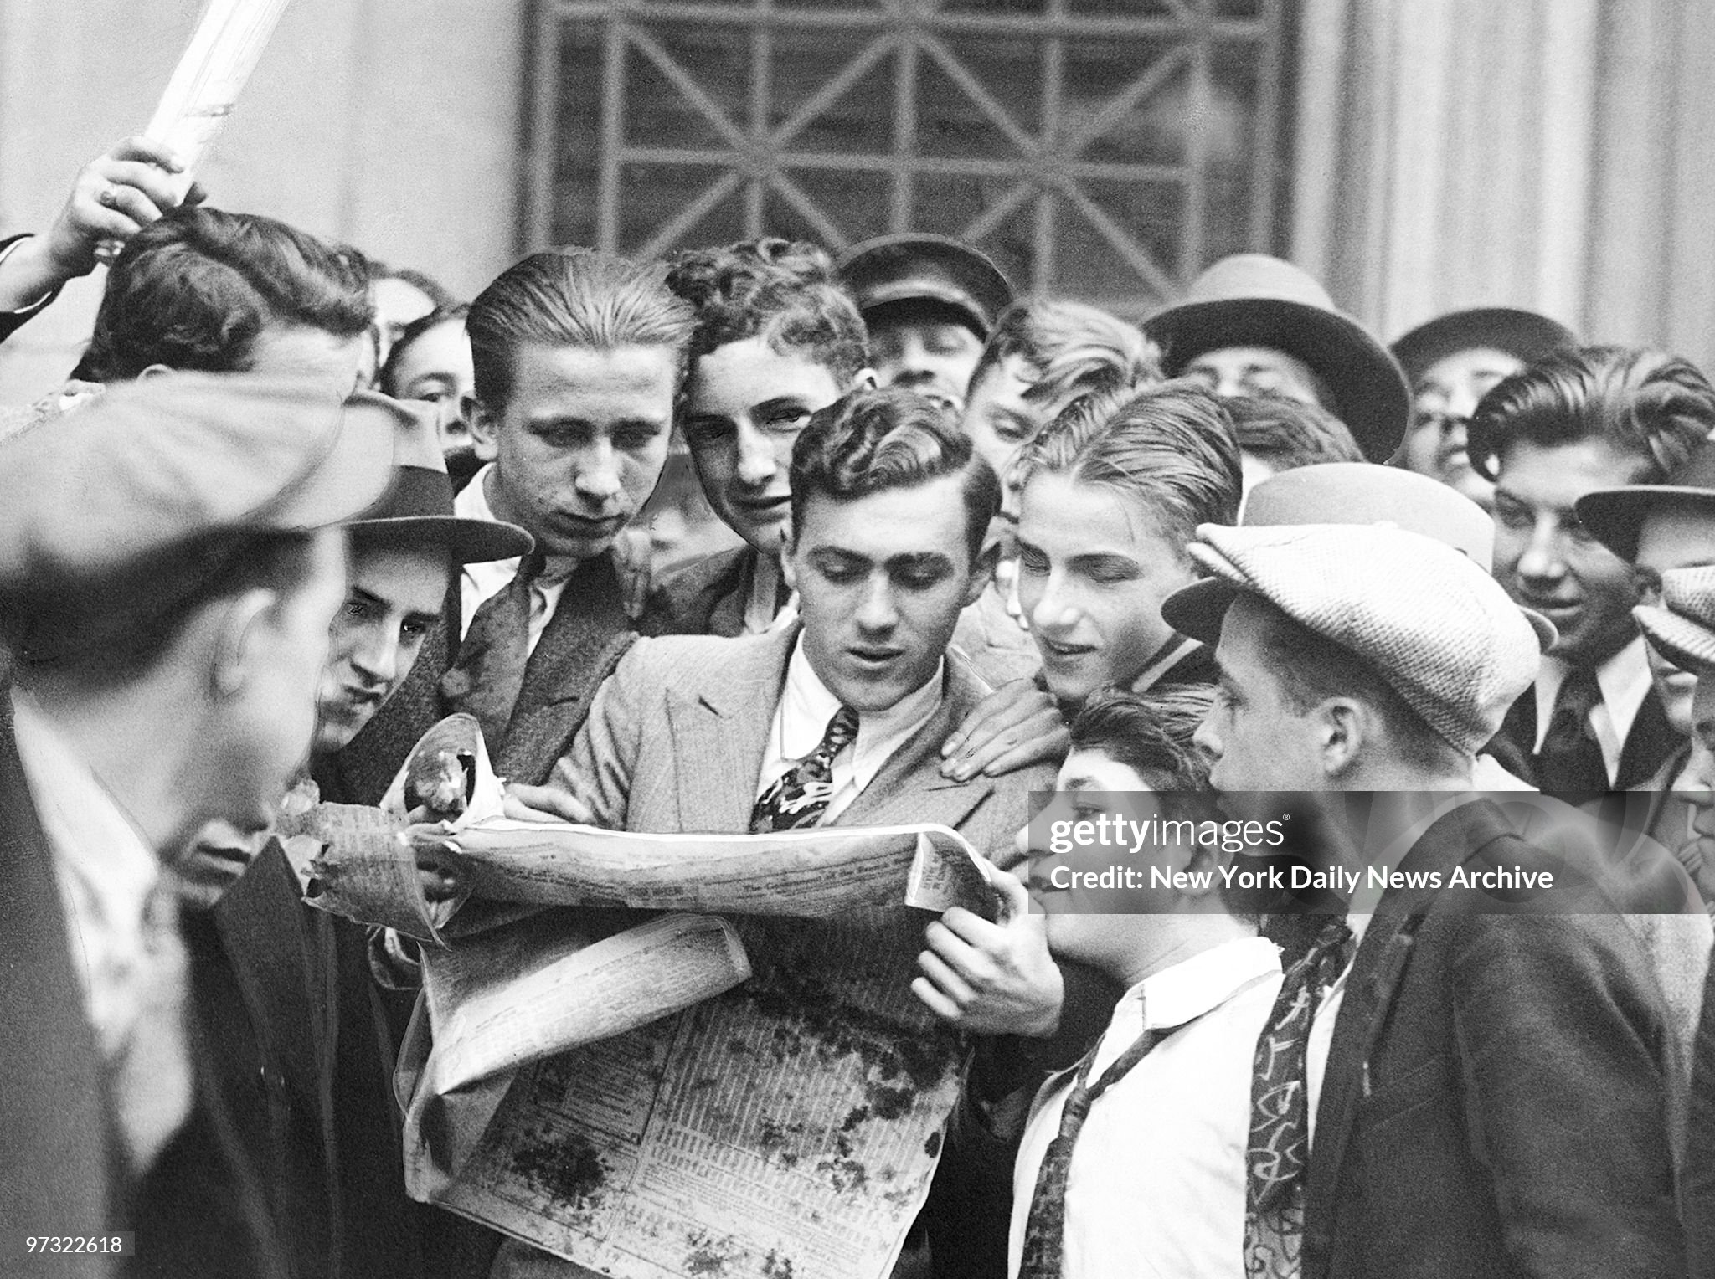
News travels and shared fast

Slide 9
…….That week-end after
“……Wall Street hummed with week-day activity. The great buildings were ablaze with lights all night as sleepy clerks fought desperately to get the accounts in shape for the Monday opening. Horrified brokers watched the selling orders accumulate. It wasn't a flood; it was a deluge. Everybody wanted to sell-the man with five shares and the man with ten thousand. Evidently the week-end cheer barrage had not hit its mark.”

Slide 10
“Black Monday” October 28th
Eyewitness on trading floor as market drops 12%:” traders hollered and screamed, they clawed at one another's collars. It was like a bunch of crazy men. Every once in a while, when Radio or Steel or Auburn would take another tumble, you'd see some poor devil collapse and fall to the floor.”
That evening…”Wall Street was lit up like a Christmas tree. Restaurants, barber shops, and speakeasies were open and doing a roaring business. Messenger boys and runners raced through the streets whooping and singing at the tops of their lungs. Slum children invaded the district to play with balls of ticker tape. Well-dressed gentlemen fell asleep in lunch counters. All the downtown hotels, rooming houses, even flophouses were full of financial employees who usually slept in the Bronx. It was probably Wall Street's worst night. Not only had the day been bad, but everybody down to the youngest office boy had a pretty good idea of what was going to happen tomorrow.”

Slide 11
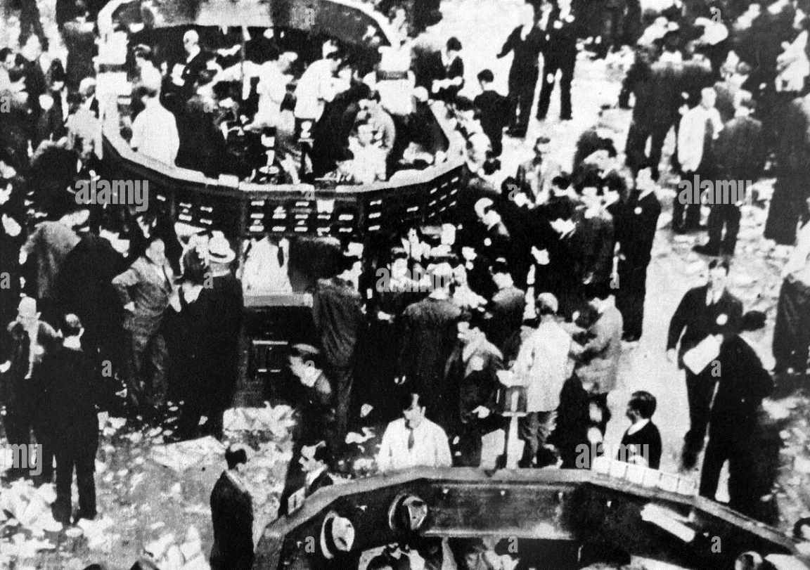
Inside the exchange Black Monday

Slide 12
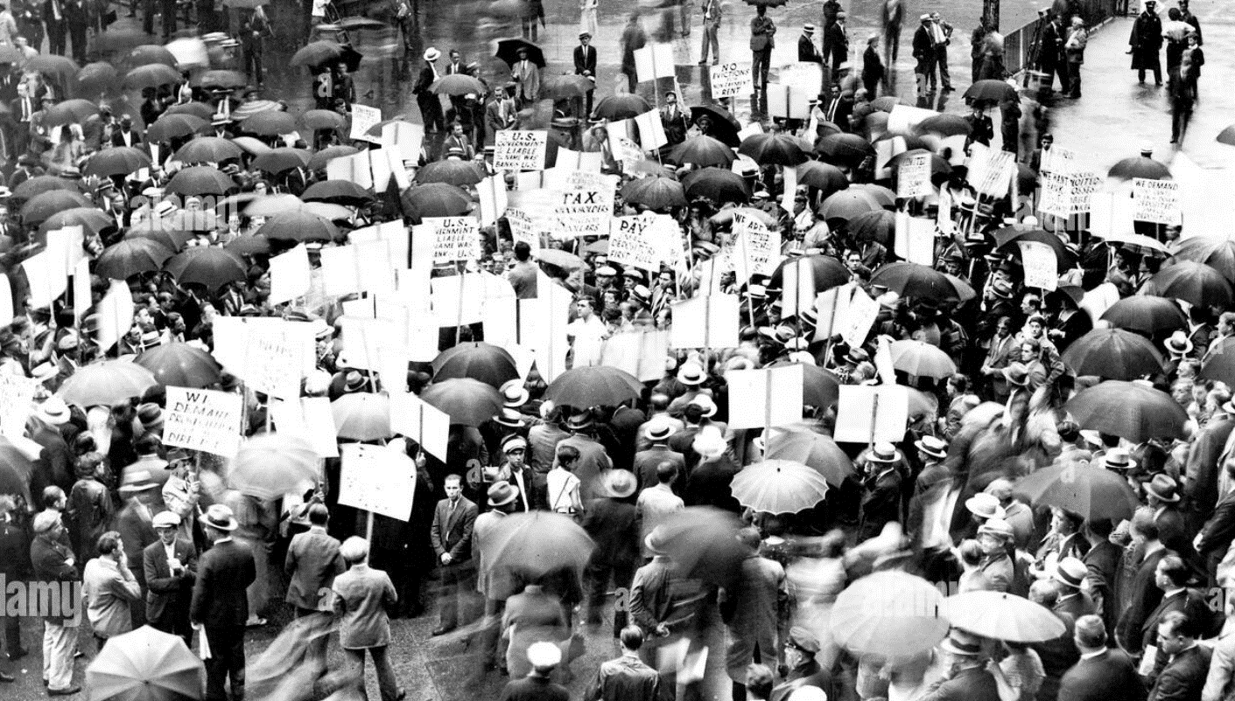
Crowds rush to Wall Street…trading expands outside….panic selling…no buyers

Slide 13
“Black Tuesday”. October 29th
Market drops another 12%
…..“ The selling pressure was wholly without precedent. It was coming from everywhere. The wires to other cities were jammed with frantic orders to sell. So were the cables, radio and telephones to Europe and the rest of the world. Buyers were few, sometimes wholly absent. Often the specialists stood baffled at their posts, sellers pressing around them and not a single buyer at any price.”

Slide 14
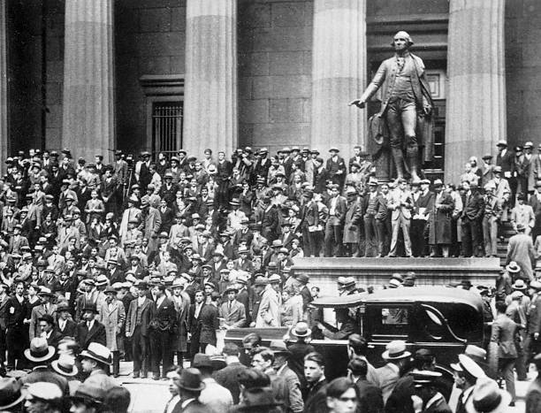
Crowds outside Wall Street

Slide 15
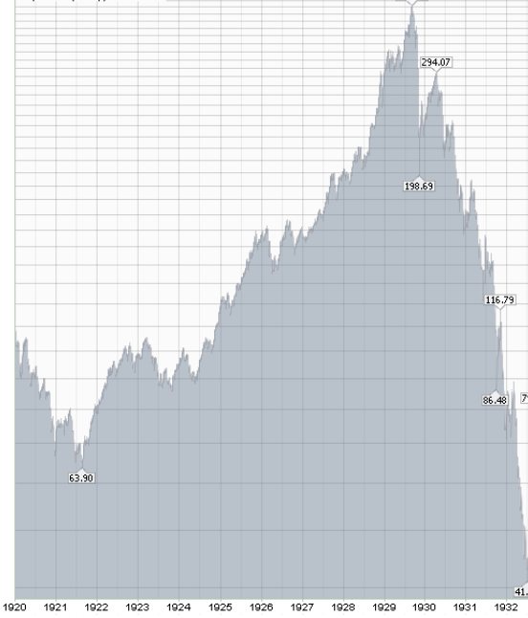
The crisis
Banks and Financiers meet to “buy any stock” to save market
Stocks continue fall…82% decline by 1932..20 years to recover
Dow Jones Index 1920-November 1932
400
CRASH
“BUY BACK”
300
200
100

Slide 16
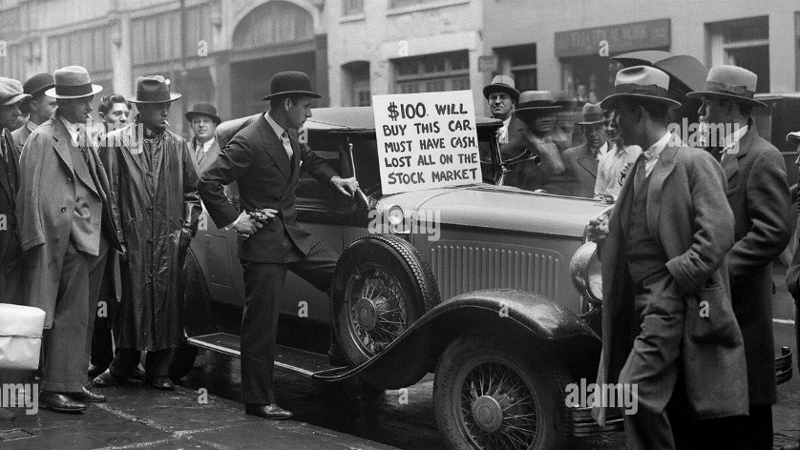
First impact: the Margin traders ….$7Bn (loaned out….cleaned out

Slide 17
Then the Banking System collapsed
System unstable
30,000 banks in US…independent, unsupervised,
Overstated ‘reserve accounting’ (cheques assets for both lending bank and financing institution!)
Federal Reserve Response “new”, slow, wrong, ineffective
Decisions require consensus from each district
“Real Bills” doctrine…lend only to solvent/ avoid ..”moral hazard” No “banker of last resort”…no deposit insurance
Loans to margin traders unrecoverable, balance sheet liquidated

Slide 18
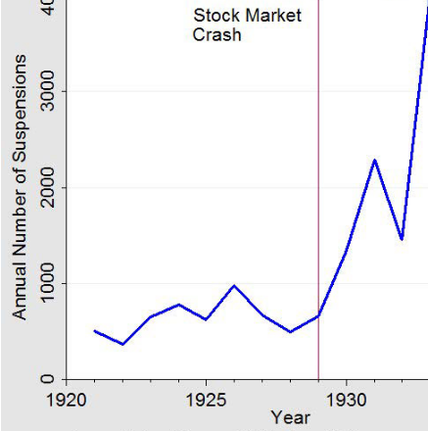
Next….the banks
Bank Failures USA 1920-1932
Depositors rush to get cash
…30% banks fail by 1933
….20% loss in national savings
Credit Money/ loans called
…money supply shrinks by 30% within two years

Slide 19
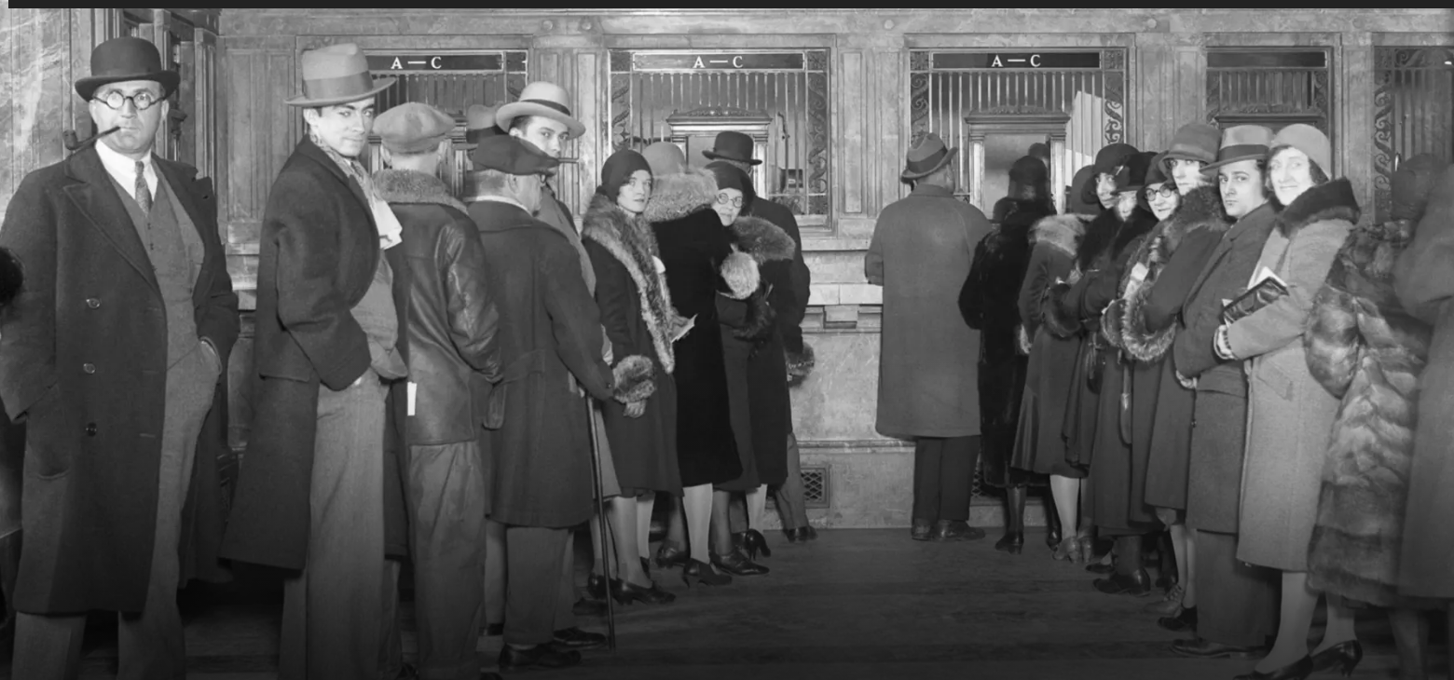
Recovering deposits (or not)..calm inside?

Slide 20
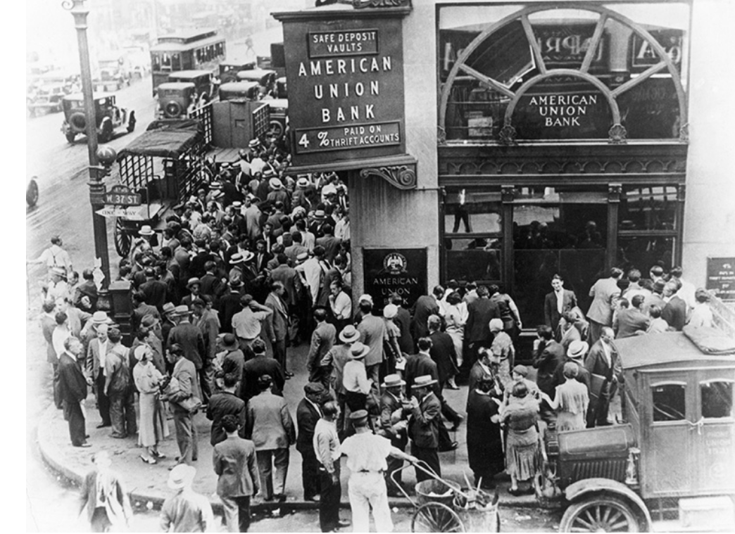
Bank Runs..outside it is not calm

Slide 21
Next…”real economy contracts
Output declines, unemployment soars, prices decline
 | GDP per capita | Prices | Unemployment
1929 | $7,500 | + 2% | 3%
1930 | $6,300 | 0% | 10%
1931 | $6,000 | -7% | 15%
1932 | $5,000 | -10% | 20%
1933 | £4,800 | -10% | 25%

Slide 22
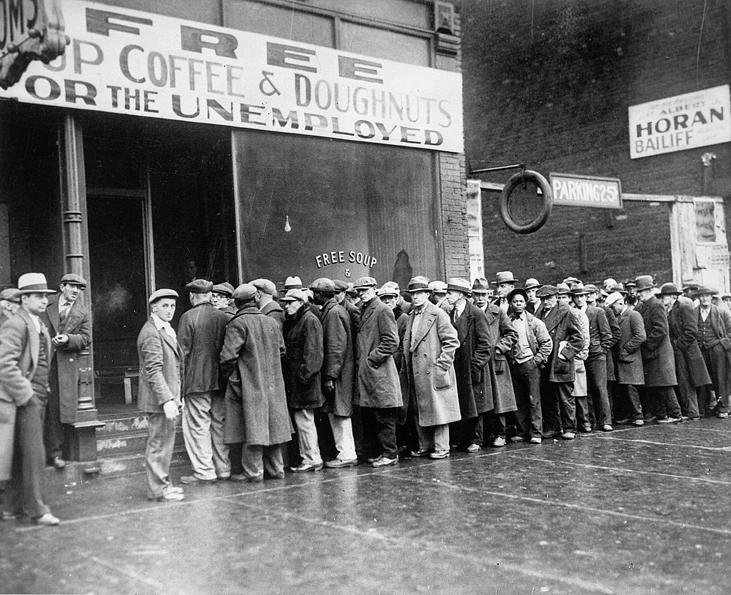
Soup Kitchens replace “speak easies” ….funded by charities….even gangsters

Slide 23
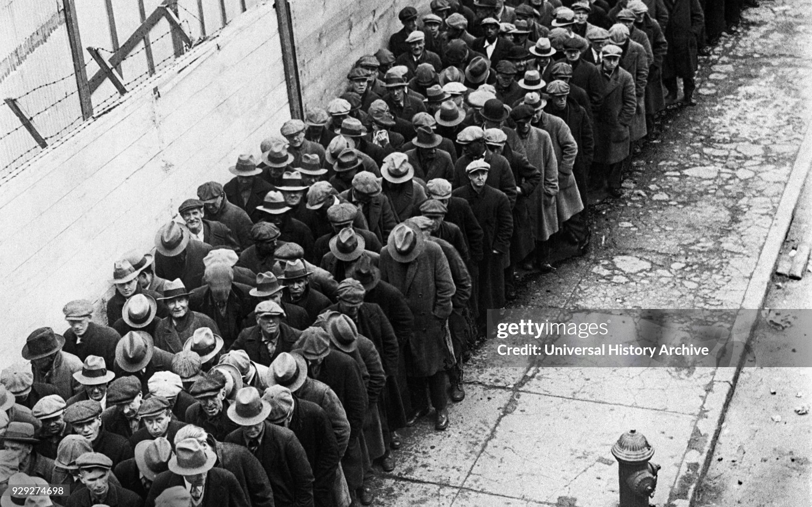
Queuing up for food

Slide 24
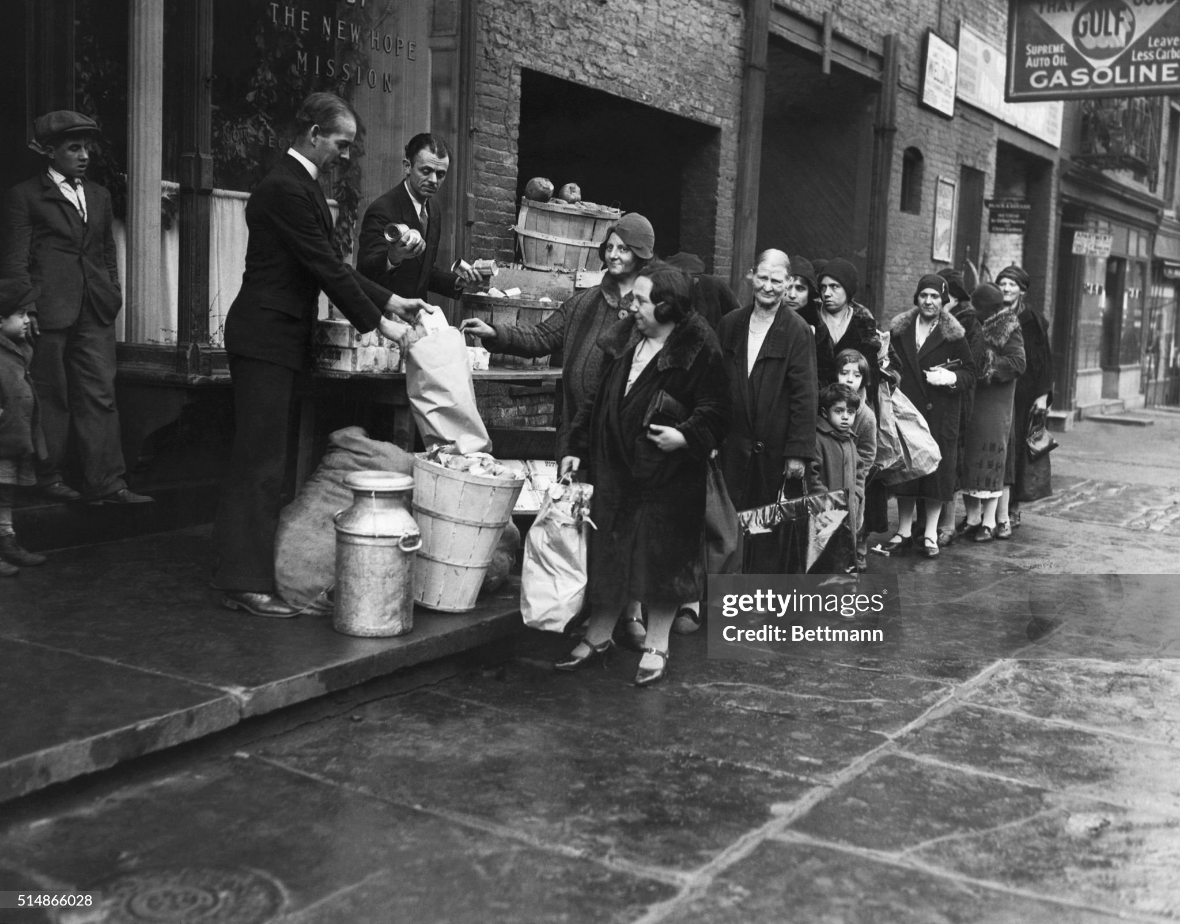
Food bank New York City

Slide 25
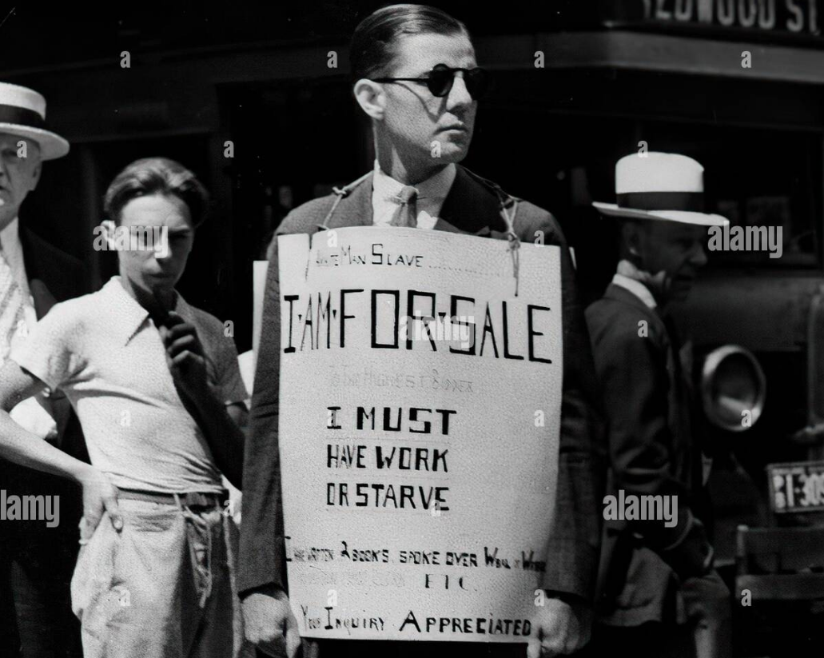
………….Even the desperate can look “cool”

Slide 26
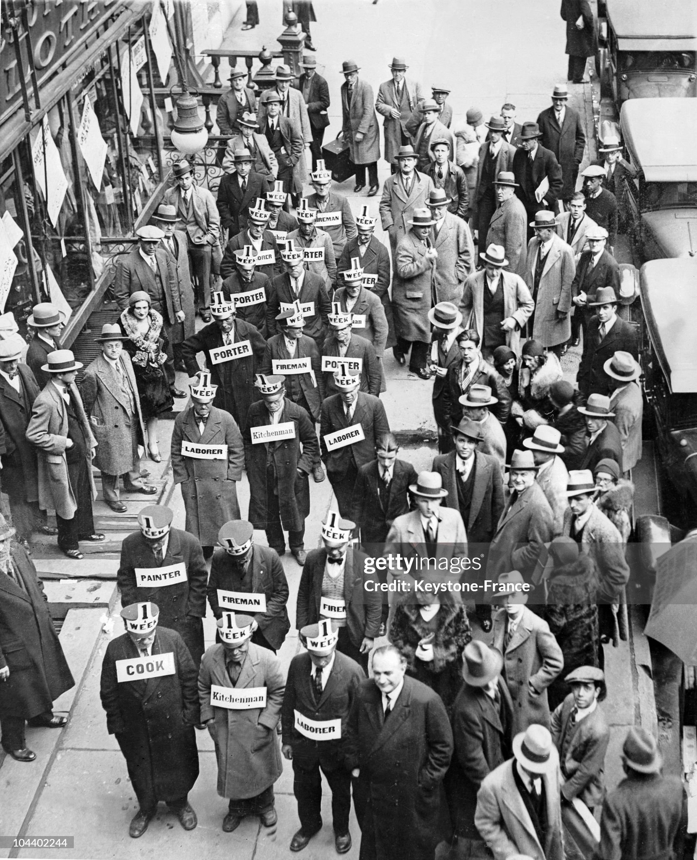
Advertising for work

Slide 27
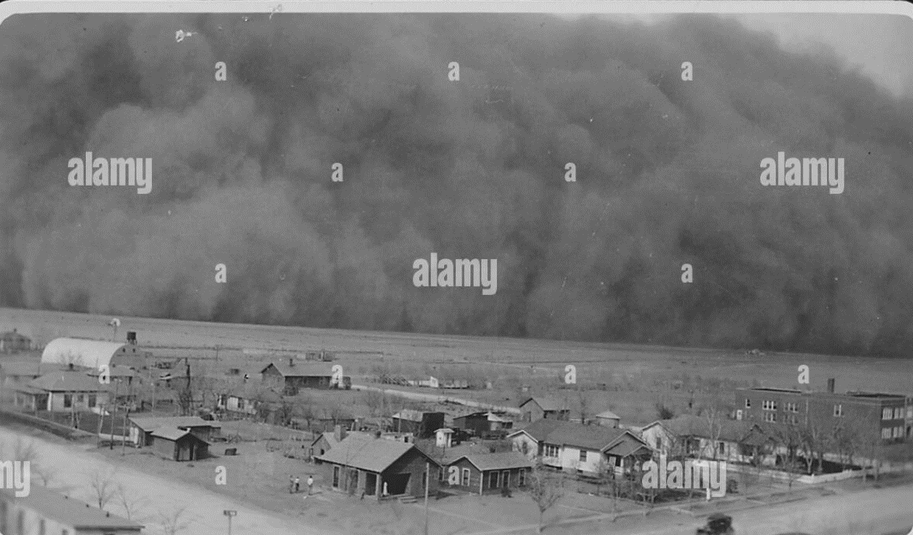
Next….environment catastrophe

Slide 28
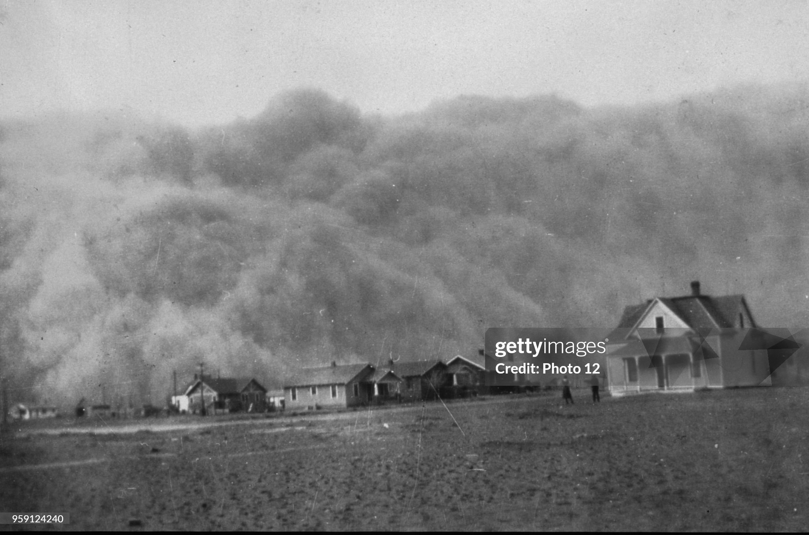

Slide 29
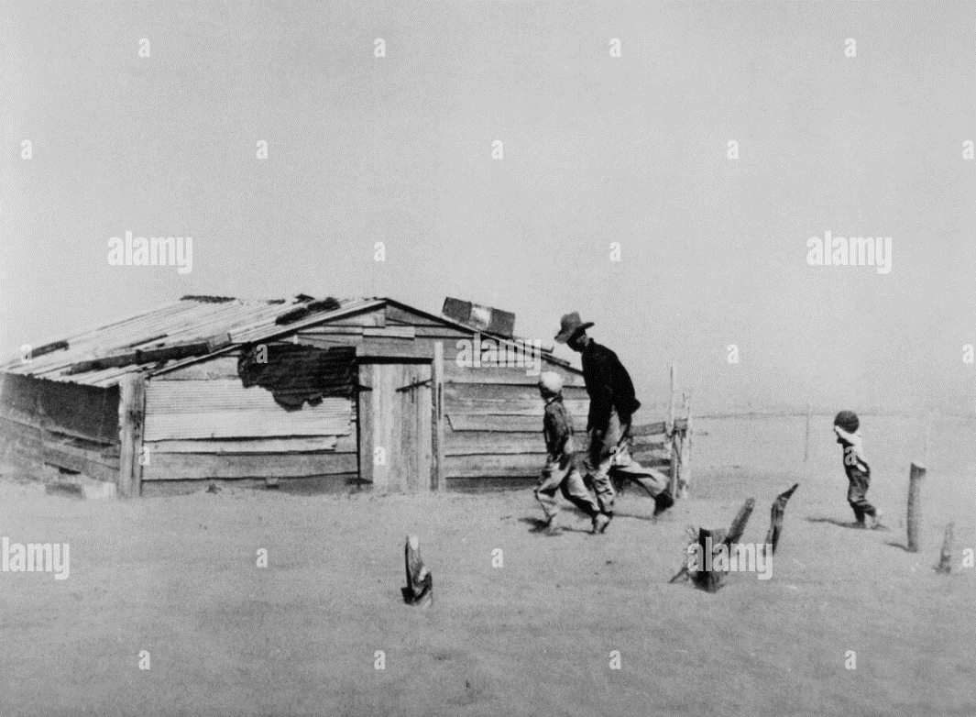

Slide 31
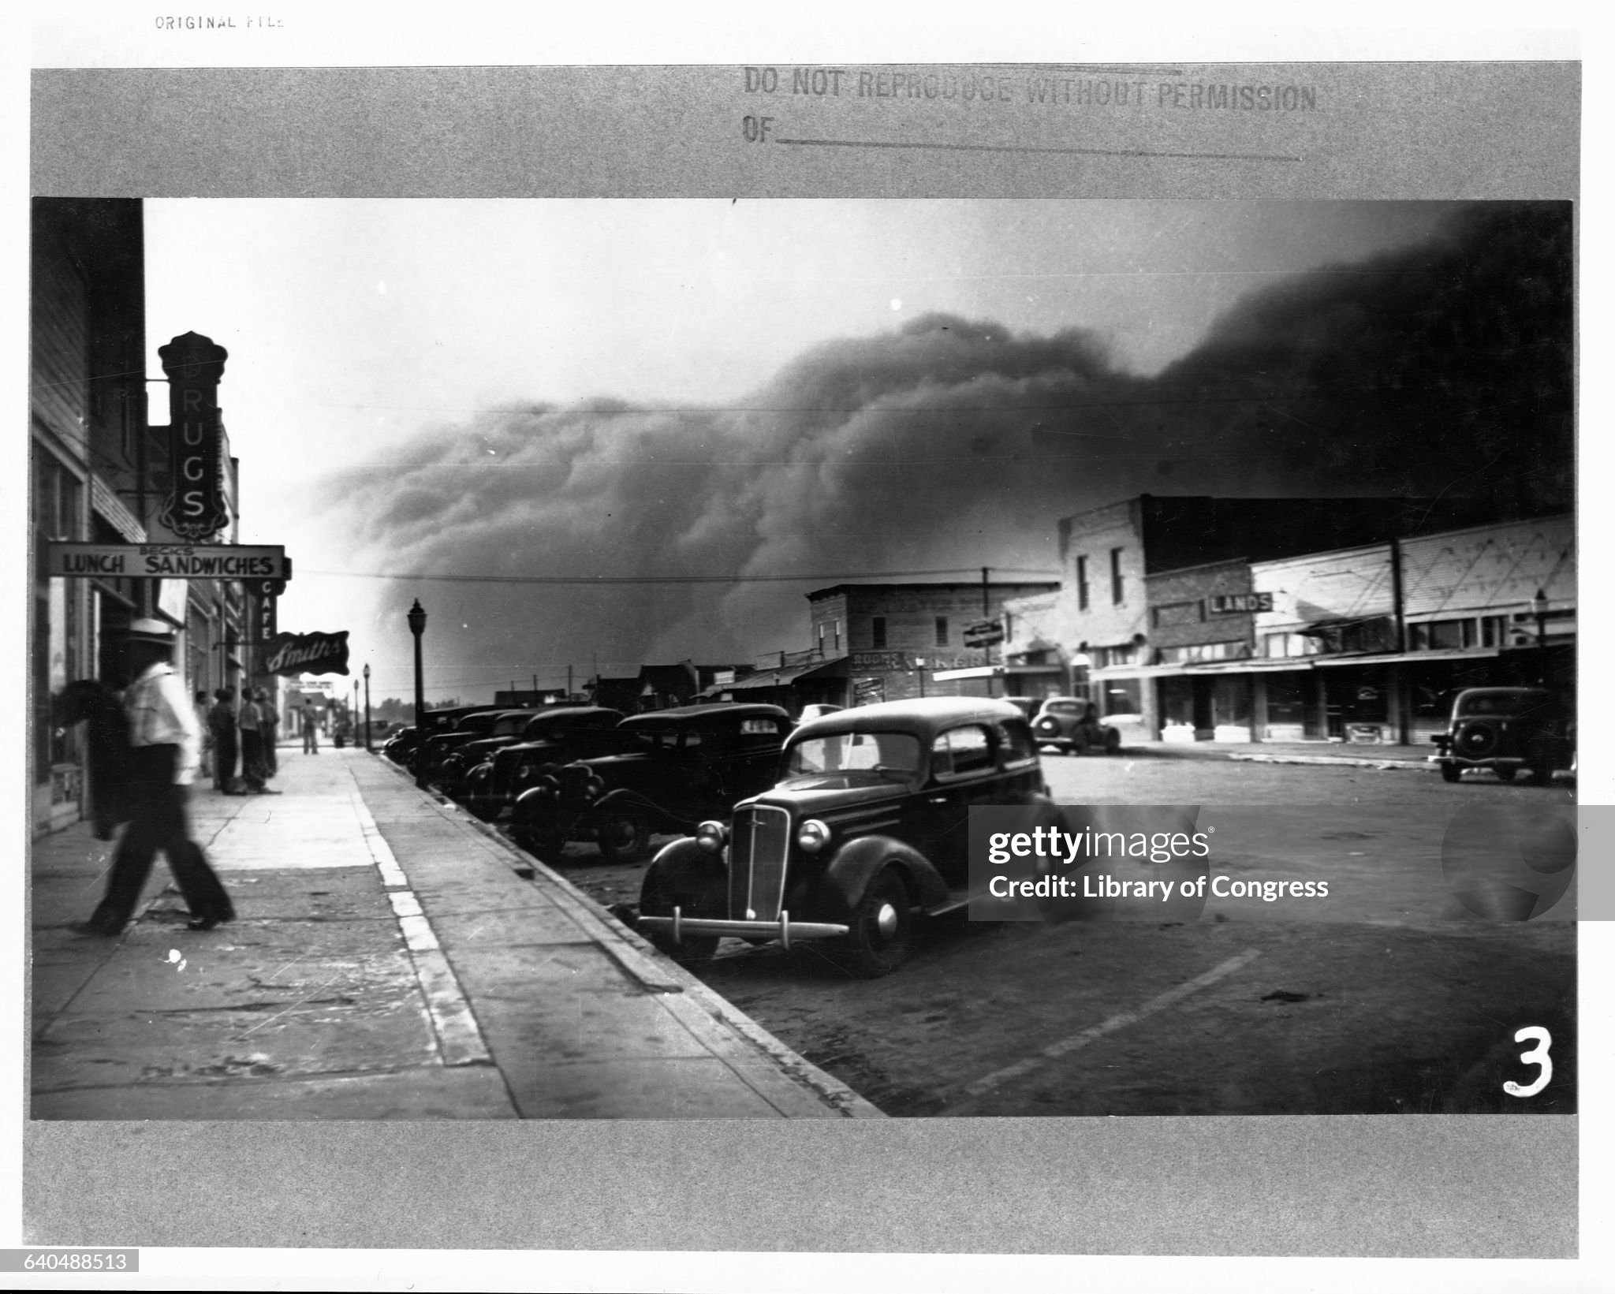

Slide 32
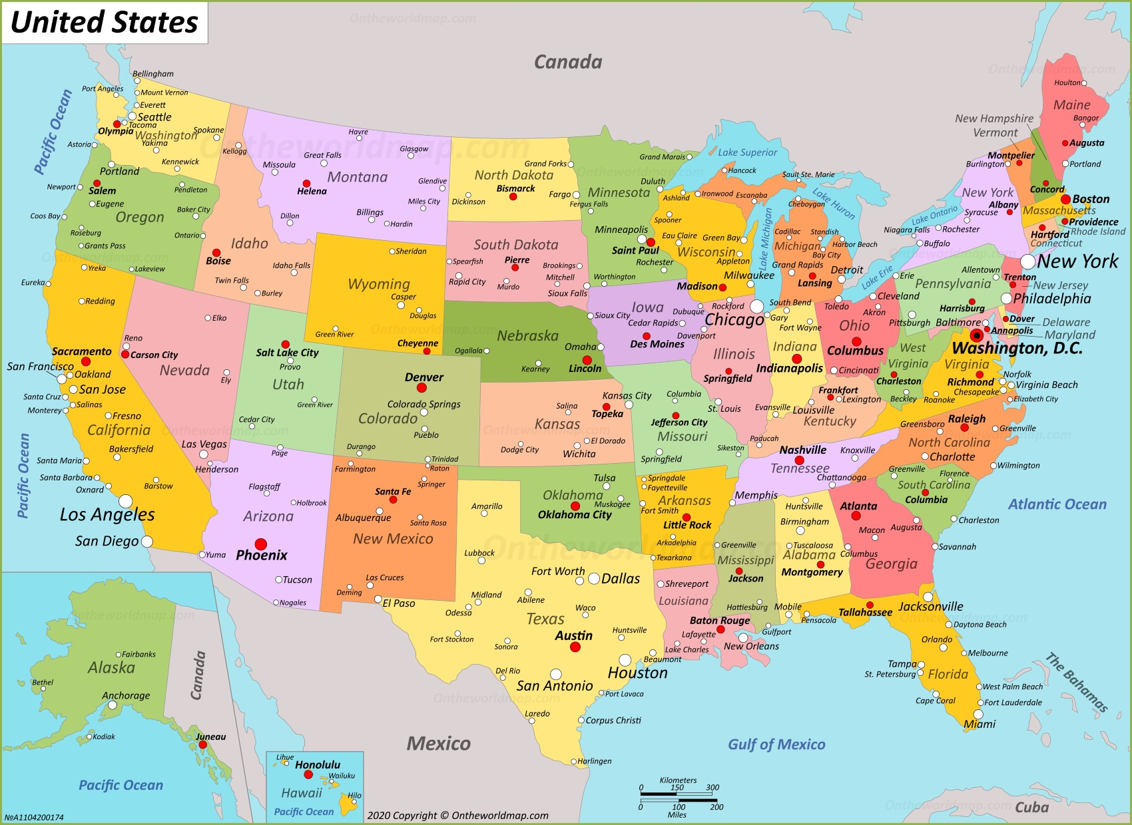
Dustbowl (1930-1940)
Homestead Act 1862
…free land
…move West post war
“Rain follows the plough”
…wet period 1880-1900
Mass increase deep
Plough farming
….Increase WW1 during ….offset lower prices as European farms recover
Dust Bowl
“Normal” drought
Returns 1930

Slide 33
Dustbowl impacts
Storms rage throughout 1930;s
10% farms destroyed
500,000 homes abandoned
3,500,000 people migrate from rural areas
Migrants 15% California population of 7million by 1940
Resettlement camps established California/ Texas
Discrimination vs “Okies”
Fuels “Repatriation” of Mexican immigrants…and citizens

Slide 34
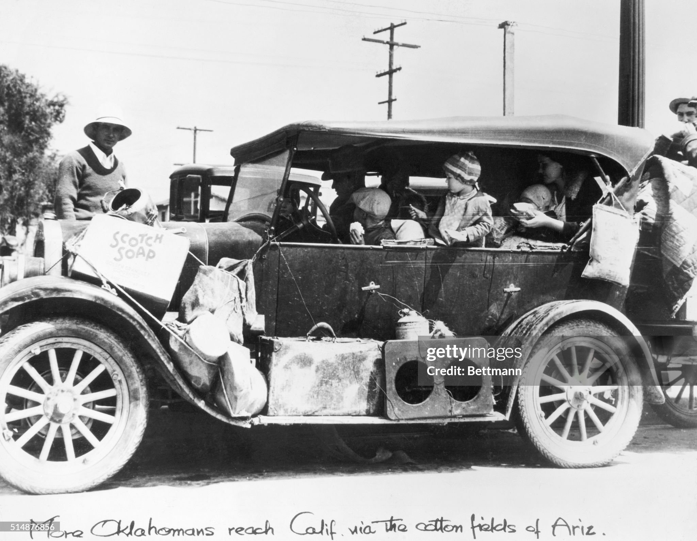
Migration by jalopies

Slide 35
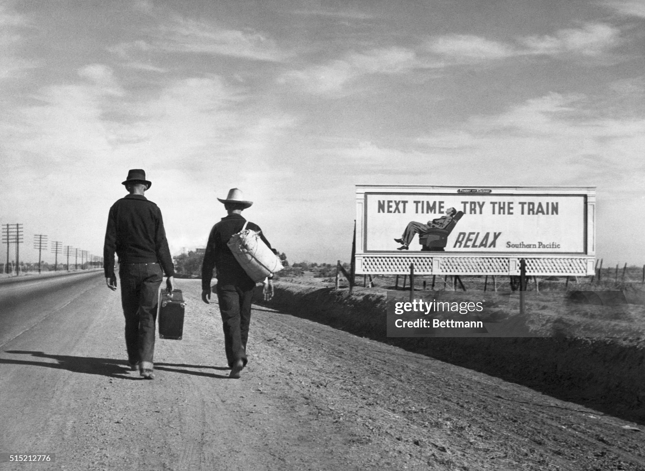
By foot….probably not by train

Slide 36
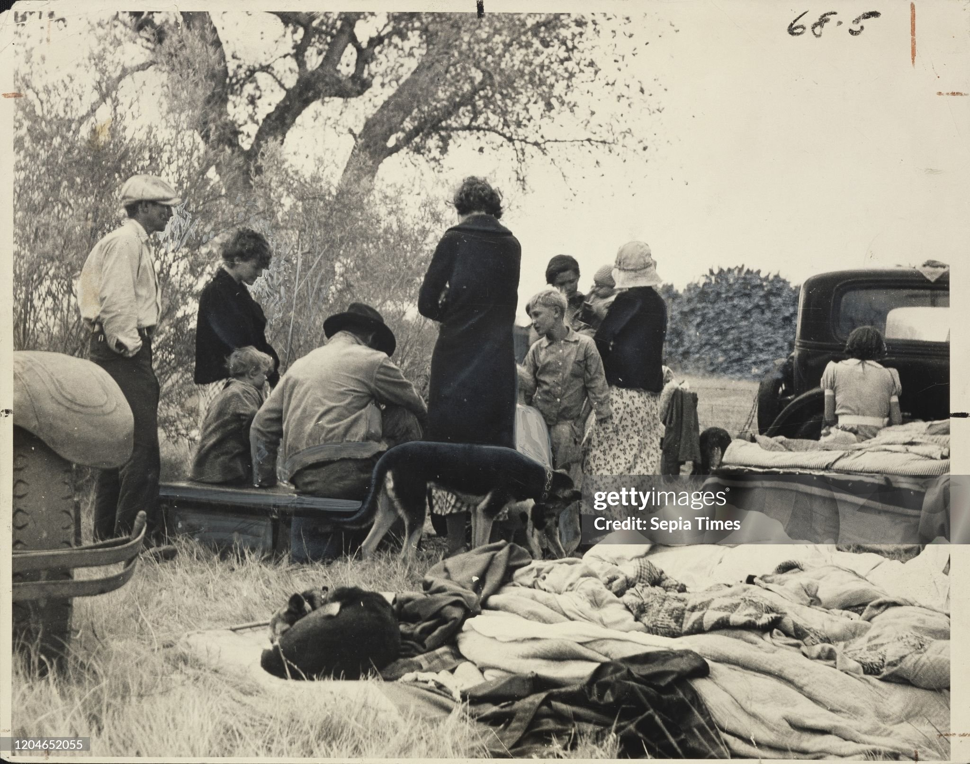
…..“Home” is wherever you can find it

Slide 37
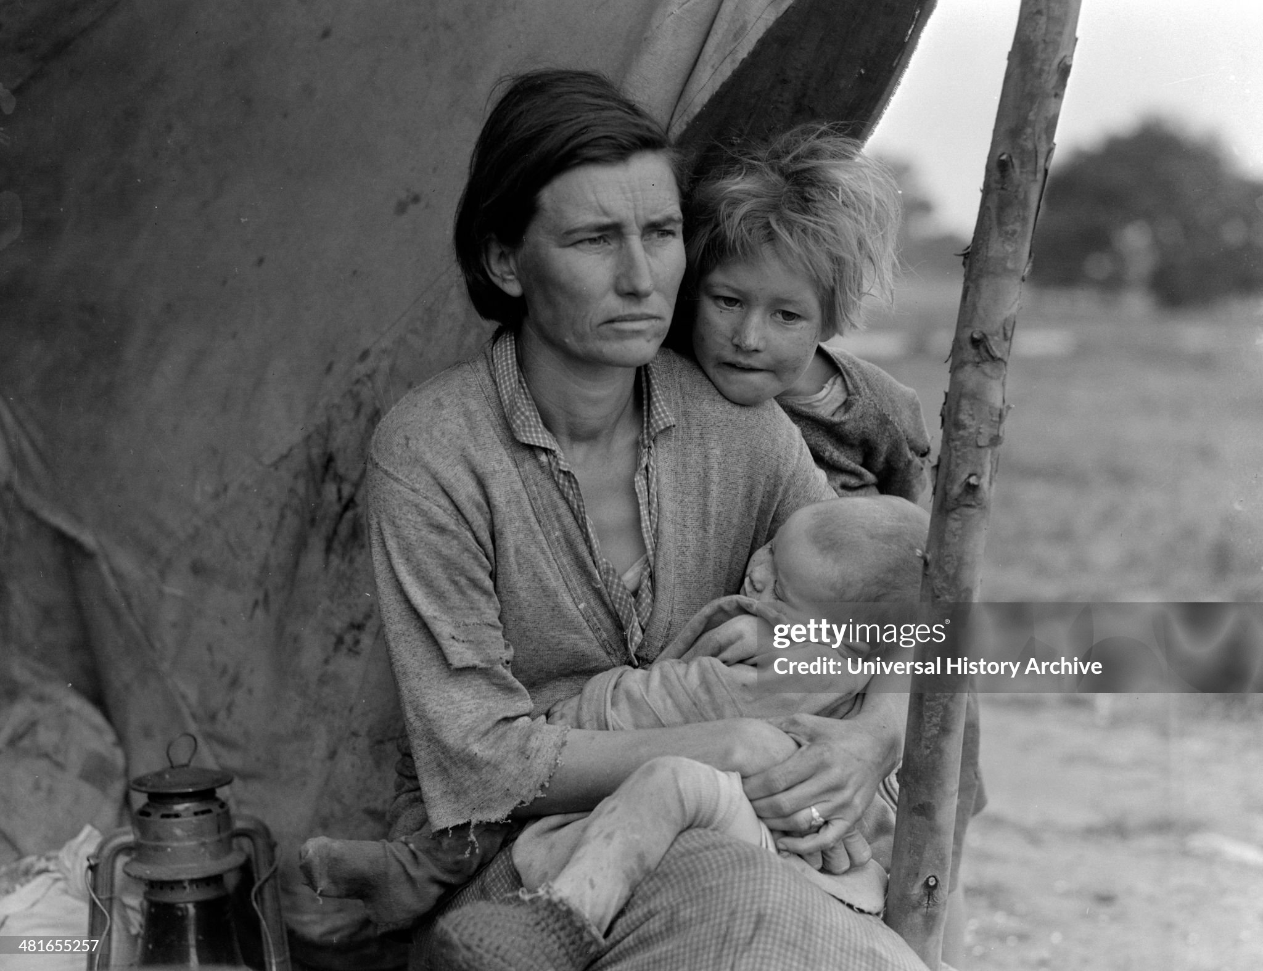
The future….bleak

Slide 38
Responses to the Depression

Slide 39
The Republican response
Herbert Hoover….1932
“It is not the function of the government to relieve individuals of their
responsibilities to their neighbours, or to relieve private individuals of their
responsibilities to the public.”
Andrew Mellon, Secretary of Finance
"liquidate labour, liquidate stocks, liquidate the farmers, liquidate real
estate. Purge the rottenness out of the system. High costs of living and
high living will come down. ... enterprising people will pick up the wrecks
from less competent people."

Slide 40
Response 1 Increase Tariffs
The history of US tariffs
1870-1913) …average rate 40%....policy to protect industry & grow
1913-1920 …..Wilson Administration …reduced rates to 10%
1920……..Post war Recession increased rate to 15%
The Republican solution 1930
Senators Smoot & Hawley propose 50% tariff increase
Hoover initially opposes…committed to International cooperation
Refuses to veto bill…( Head of JP Morgan “I practically fell on my knees to beg the President to veto this stupid bill”)

Slide 41
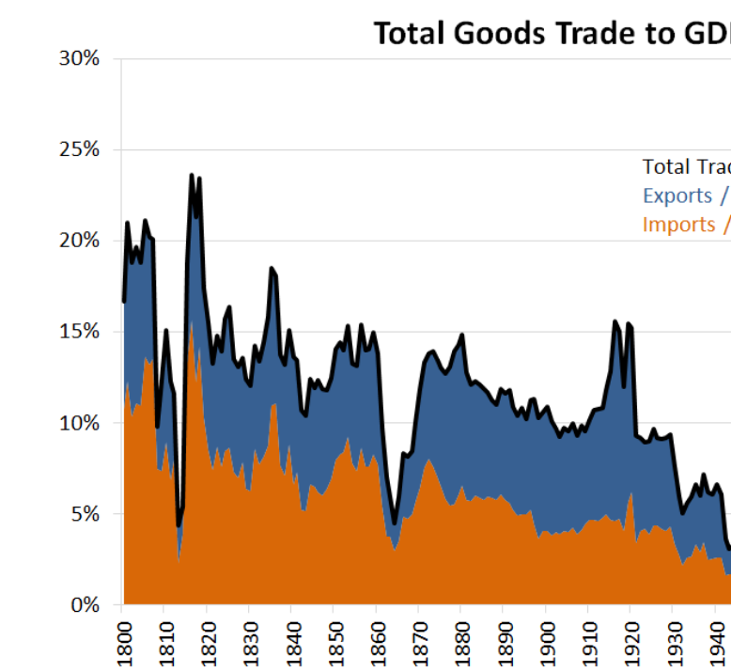
The result ….retaliation and 60% drop in exports & imports …”international trade” shrinks from 15% to less than 3% of economy

